Slide 1
WHITEBOARD
App That Helps you Recreate

Slide 2

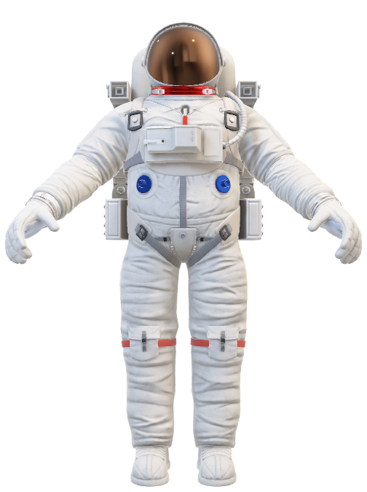
INTRODUCTION
* An online whiteboard is a great tool for collaboration and remote communication. You can create diagrams, flowcharts, drawings, and share notes all in real-time. You can also create presentations and comment on them
* I times like covid when children's are locked in home away form school, we can use this platform to help them visualise and also improve their handwriting
* By using tools such as online whiteboards, you can make remote working more simple for your entire team whether they are in or out of the office

Slide 3
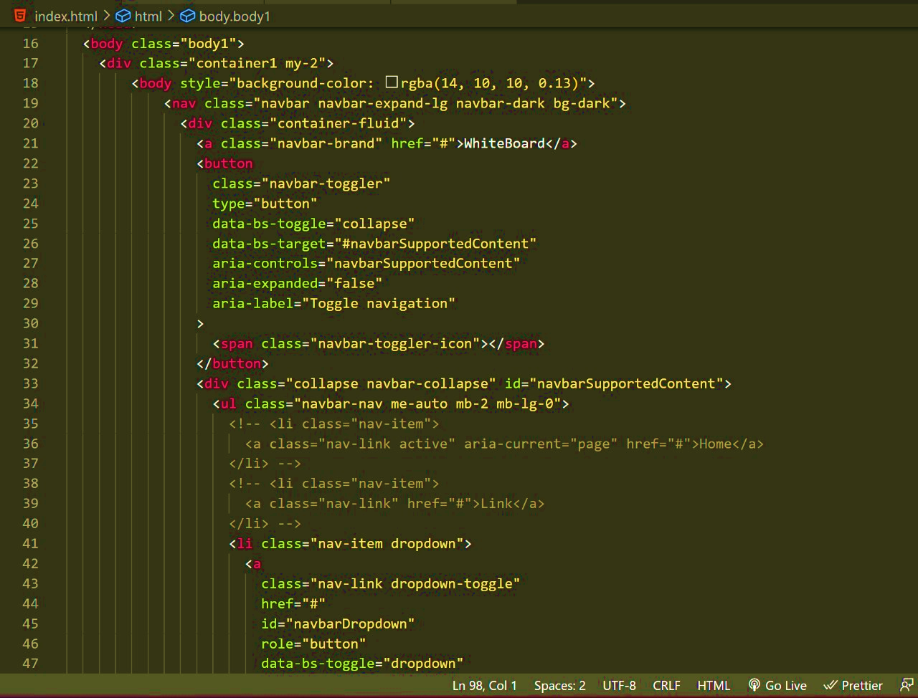
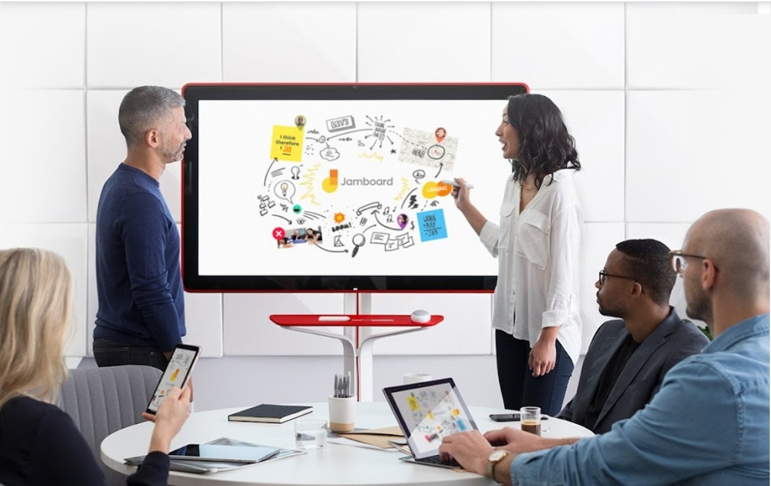
GOAL
* With white board , we want students to have the ability to find the answers and present them just as a teacher would. It gives every student a voice regardless of their level.
* We want White Board to connect with multiple collaborators who would be able to present their ideas.

Slide 4
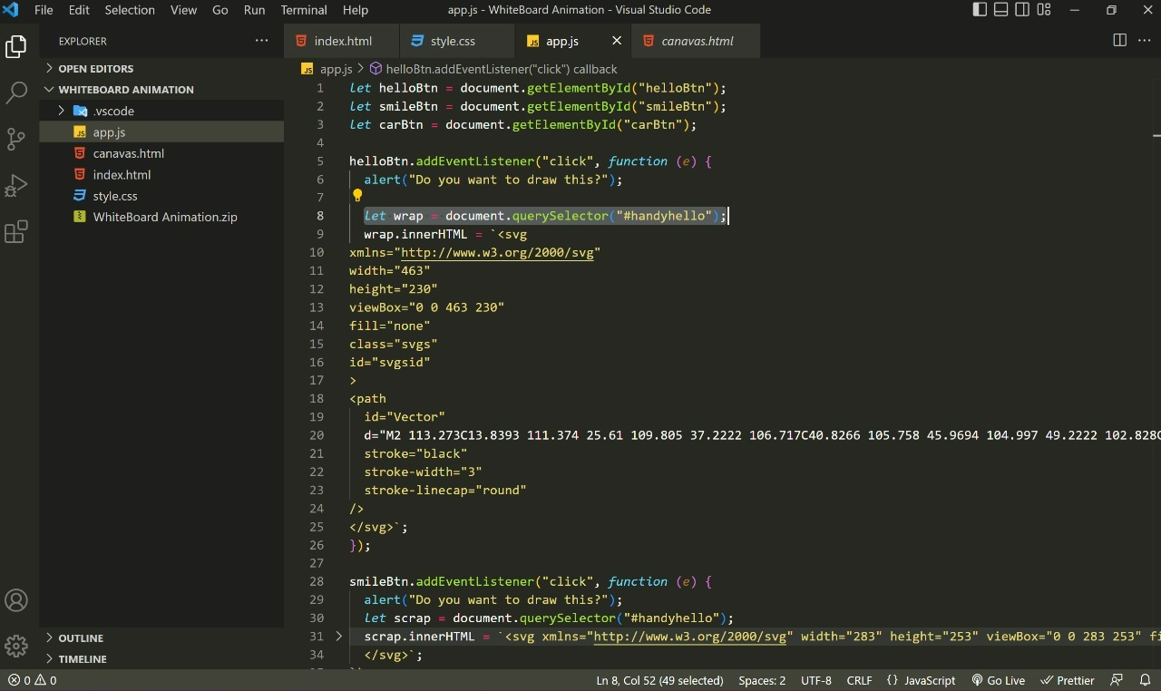
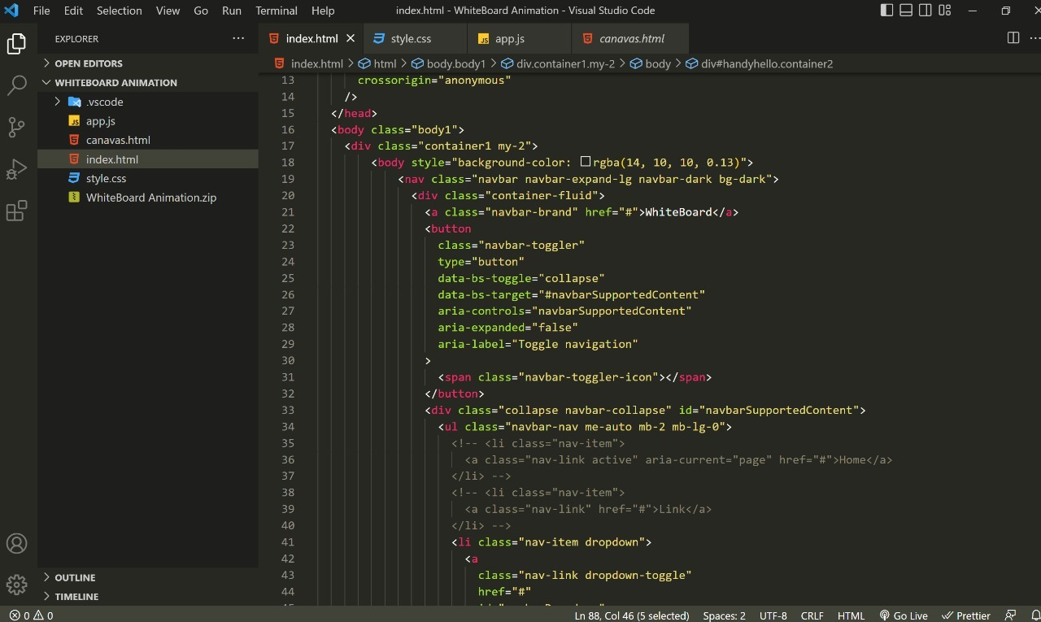
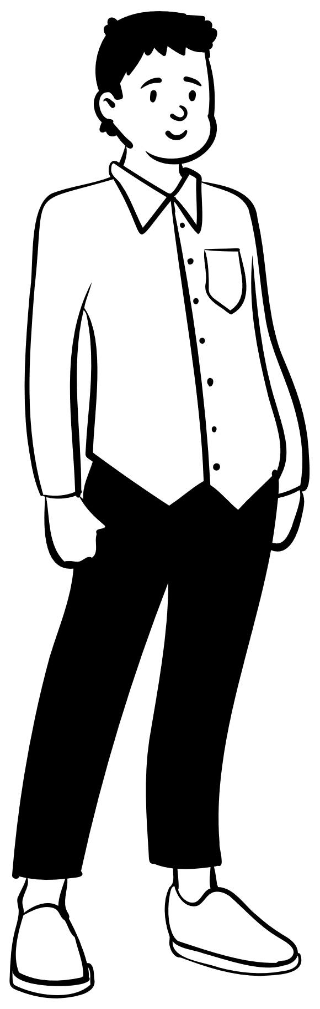







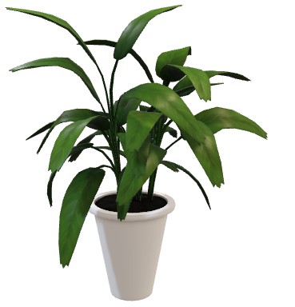
TECHNOLOGY USED
* HTML
* CSS
* JAVSCRIPT
* FIGMA
* SVG’s

Slide 5
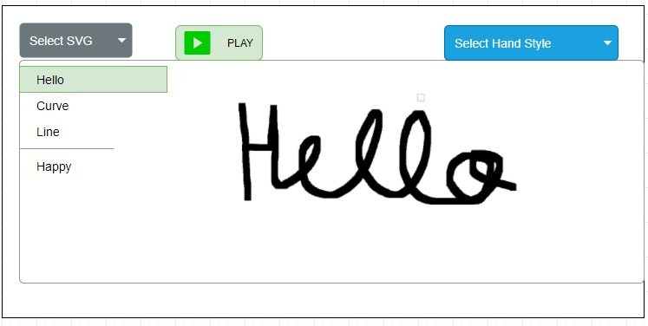
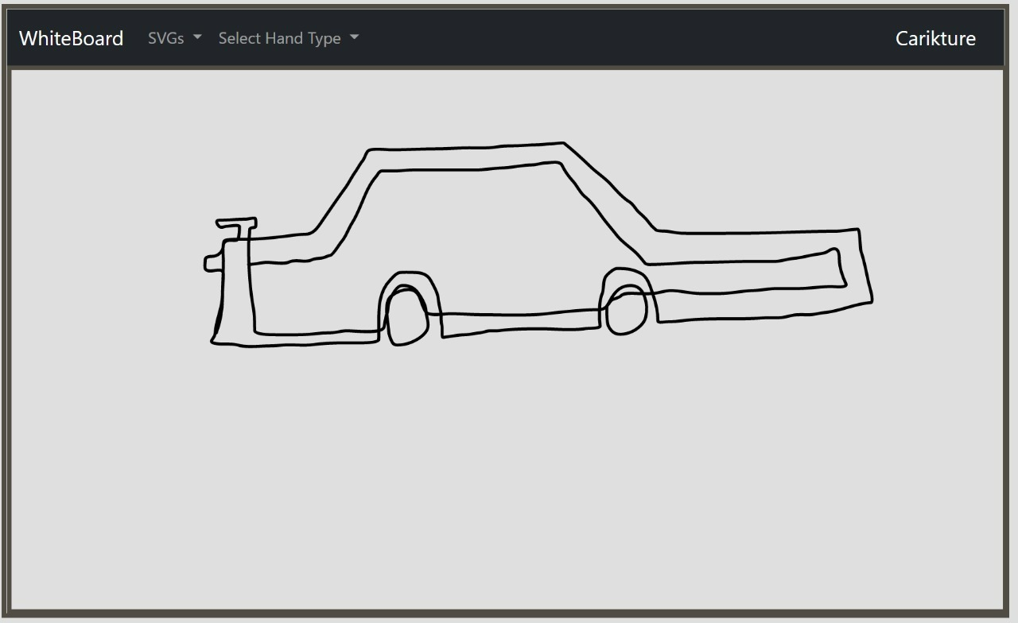
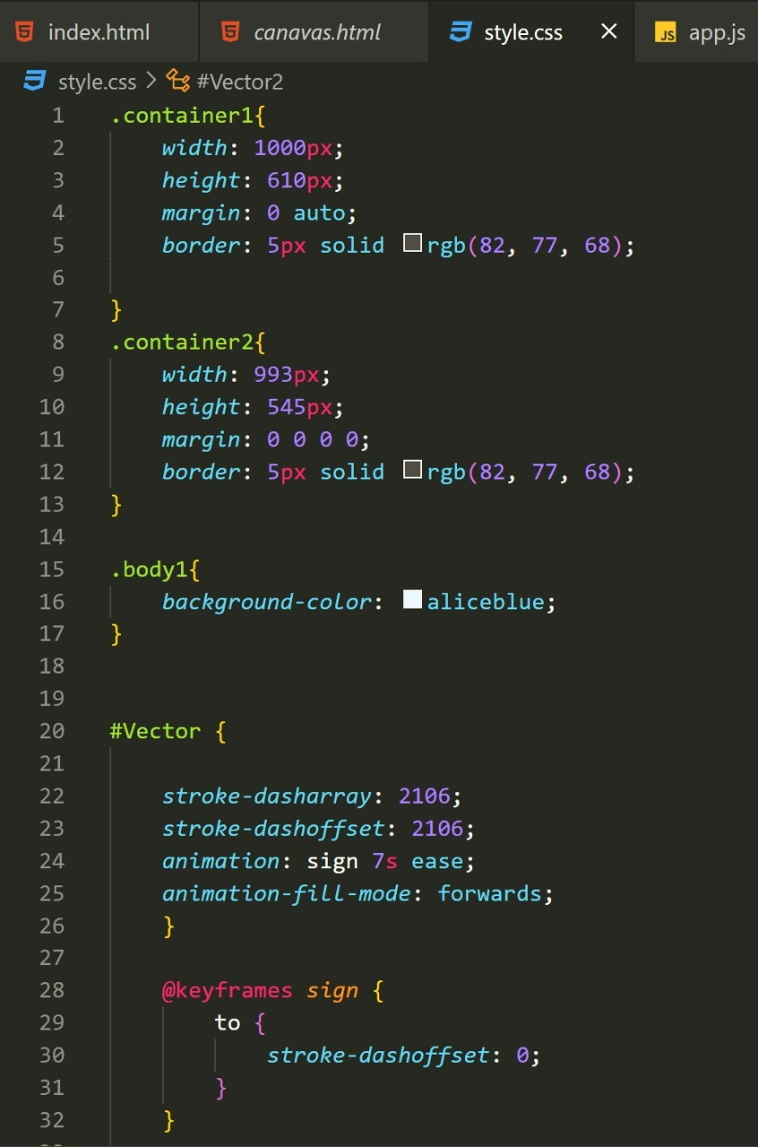
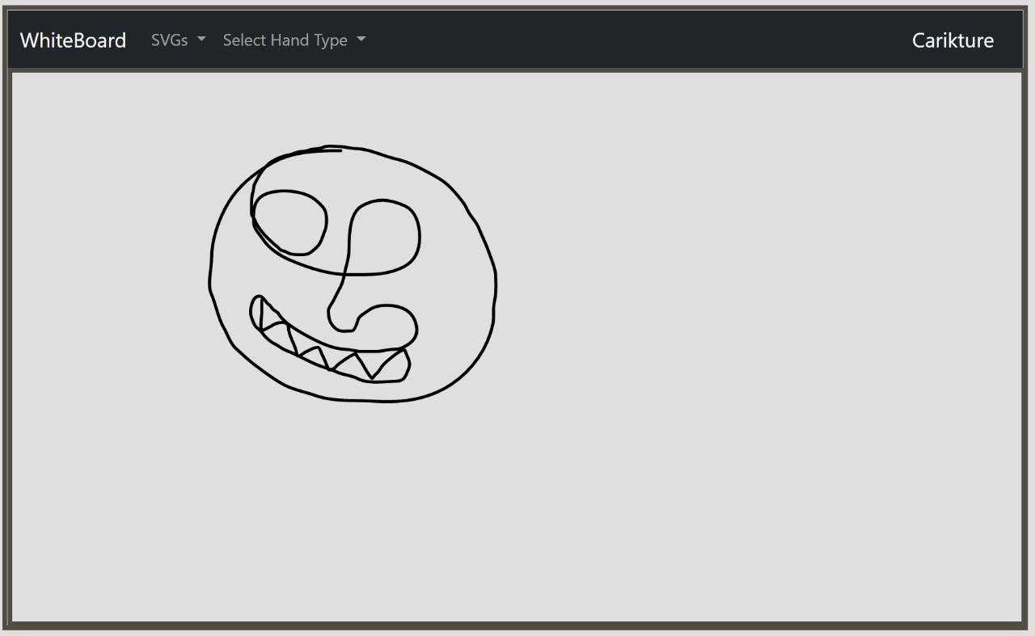
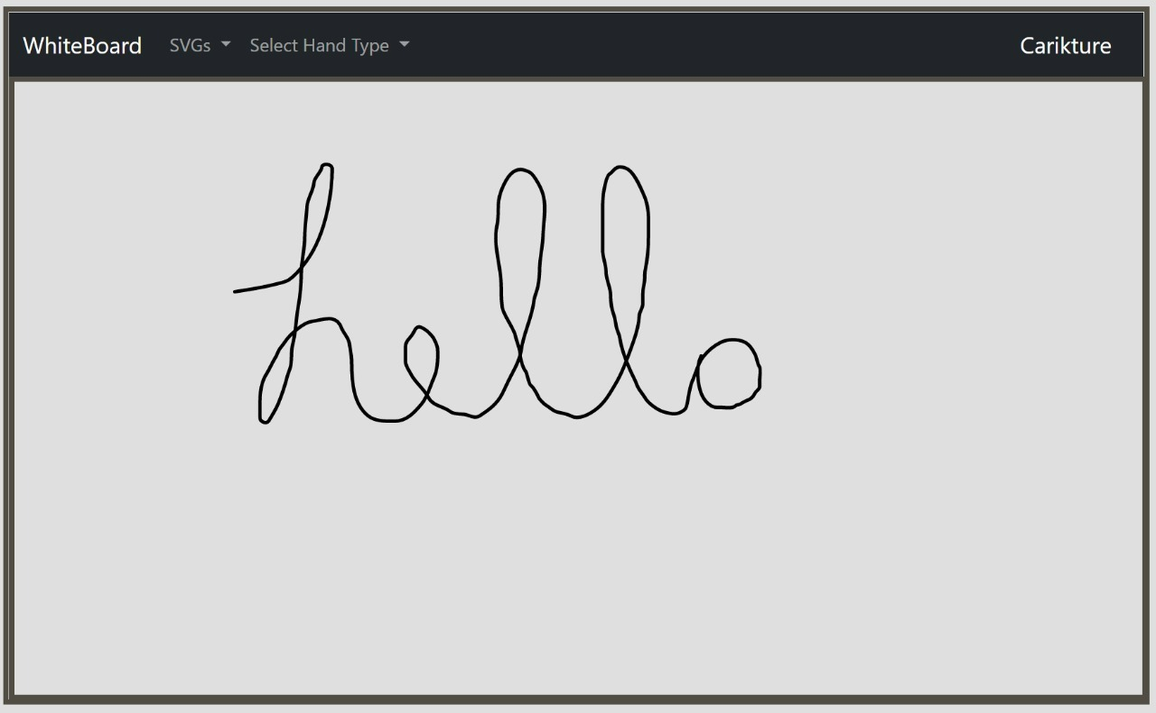
PROJECT SCREENSHOT

Slide 6
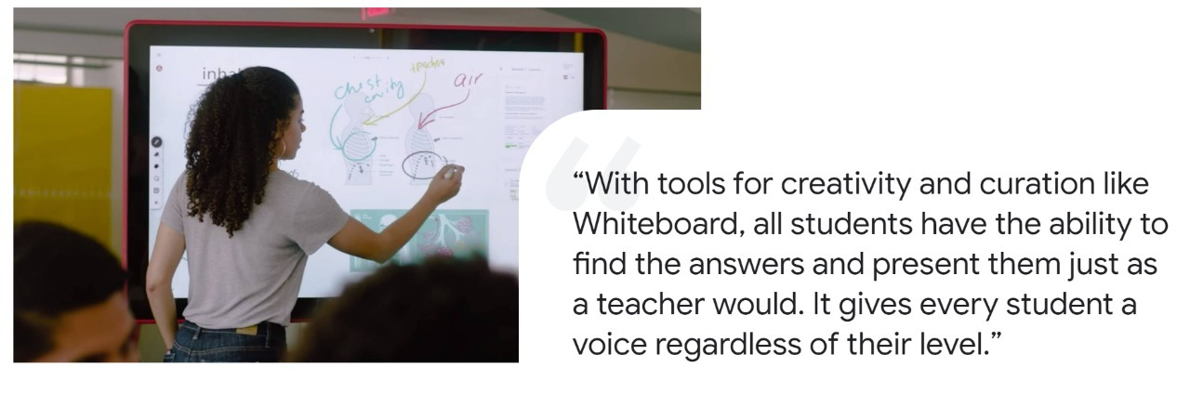
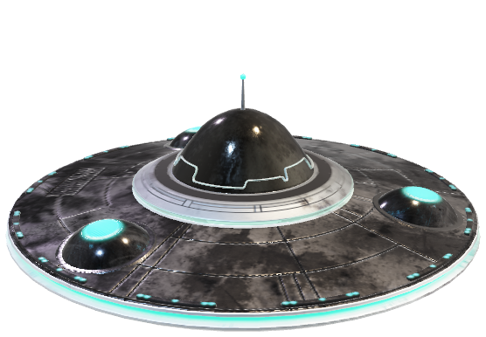
FUTURE WORK

Slide 7

CONCLUSION
In this tech driven world we want India to stand on its own ground in Edtech sector rather than being dependent on Big tech giants . We will be making this project more user friendly so that multiple collaborators can join in and work together

